Slide 1
Team Riker
Project “Number One”

Slide 2
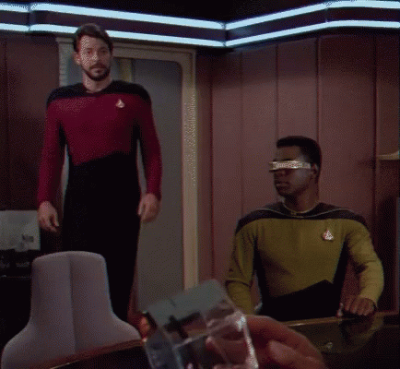

Slide 3
7 Minutes

Slide 4
> 50 Slides

Slide 5
~8 Slides per Minute

Slide 6


Slide 7
Choosing a Topic
We looked for datasets on our original topic, “accidents in surgeries” but could not find enough datasets.

Slide 8
Mental Health in Tech

Slide 9
Regretting your Topic
So we ended up spending all our time on data cleanup from a long running annual survey with no consistent schema

Slide 10


Slide 11
Mental Health in Tech
The Data

Slide 12


Slide 13
Wrong Data

Slide 14
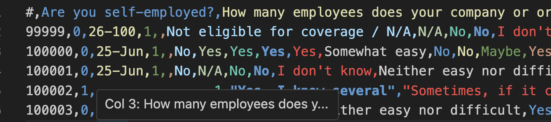
Some data is plain text

Slide 15
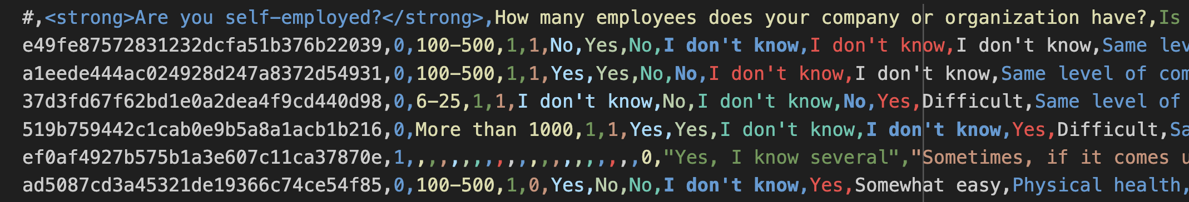
Some data has Html

Slide 16
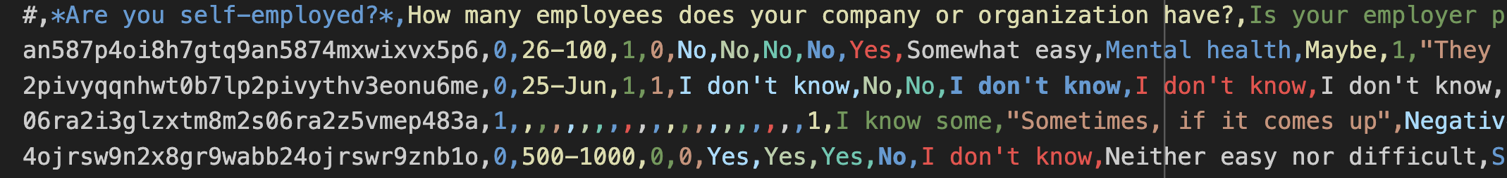
Some has markdown

Slide 17


Slide 18
The Data is “Suboptimal”
We put ourselves in a significant bind due the the extremely messy nature of our data. However, we intended, regardless of grade to do our best and learn more in the process.

Slide 19
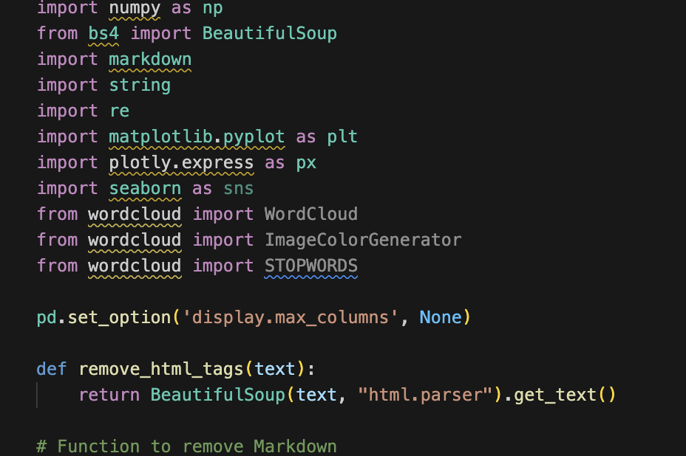
So we began our journery

Slide 20
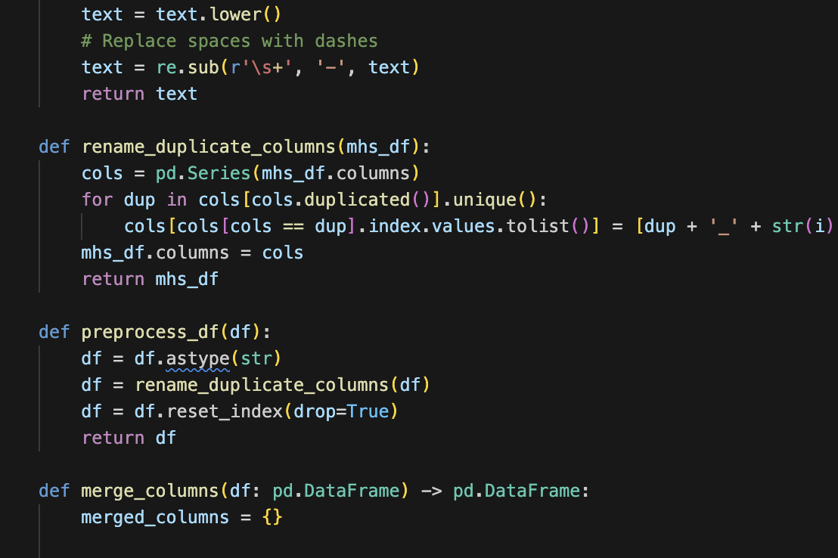
Wrote some functions

Slide 21
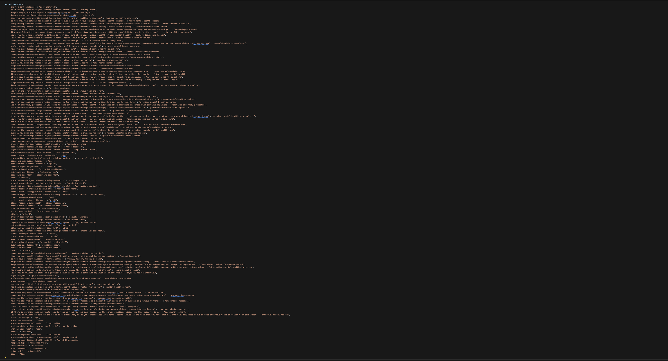
Wrote a Column name mapping Dictionary

Slide 22
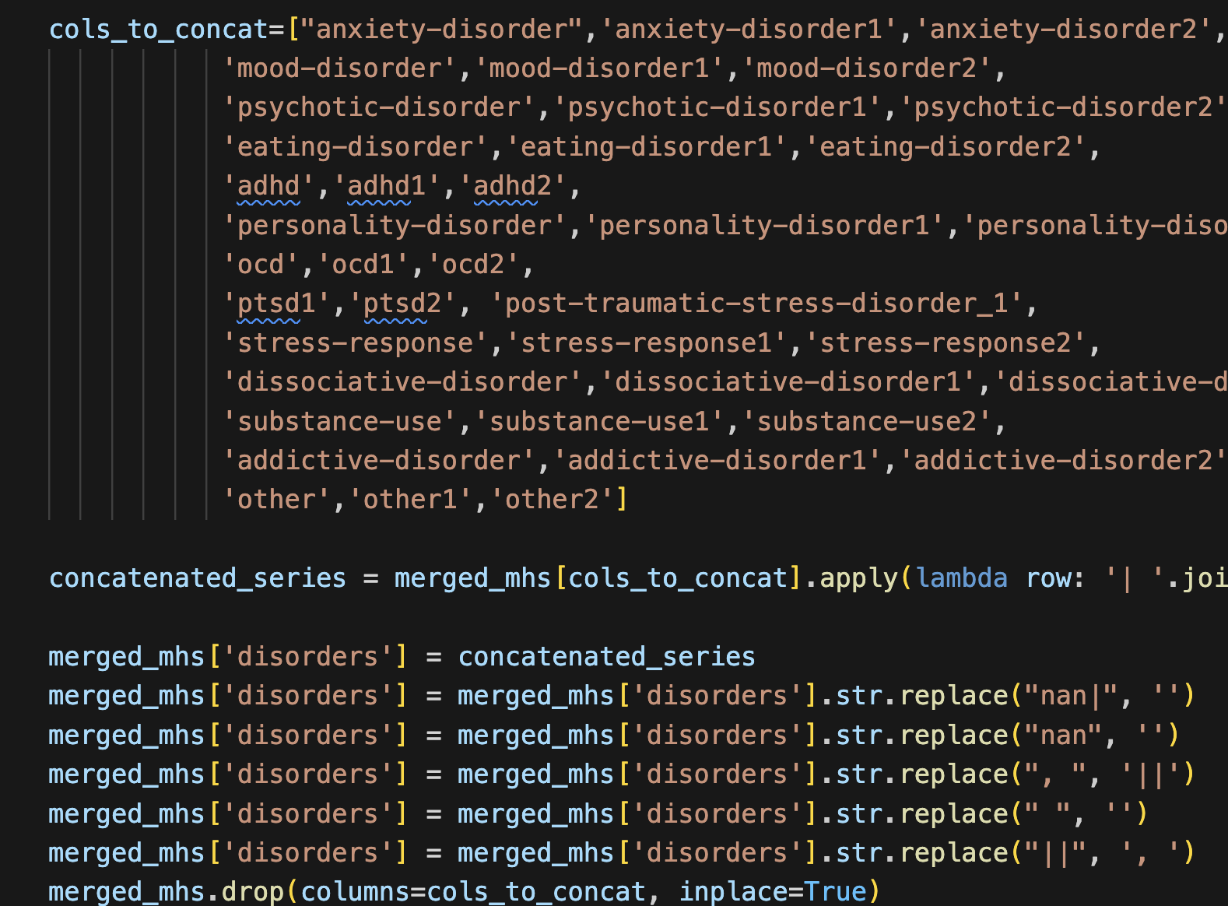
Concatenate Qualitative columns for cleaning

Slide 23
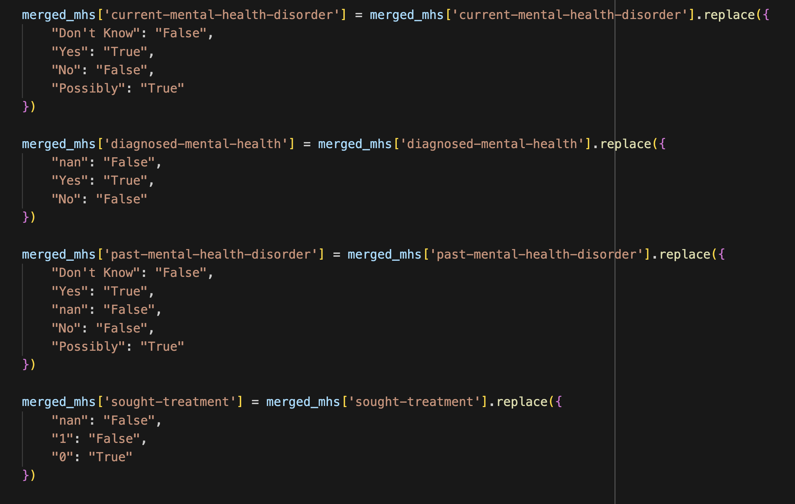
Made the values consistent on 125 cols

Slide 24
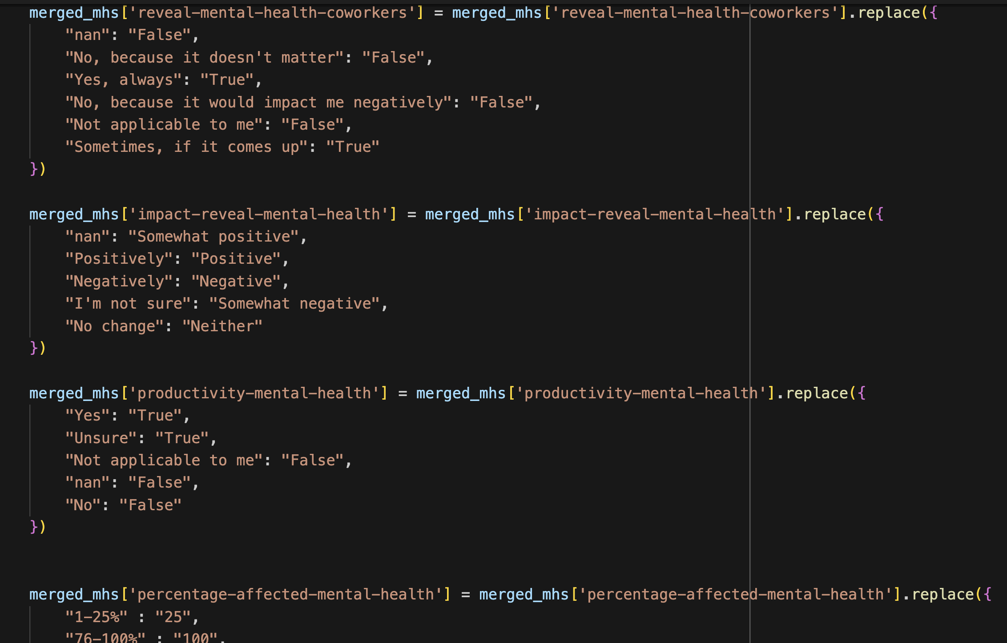
Made the values consistent on 125 cols

Slide 25
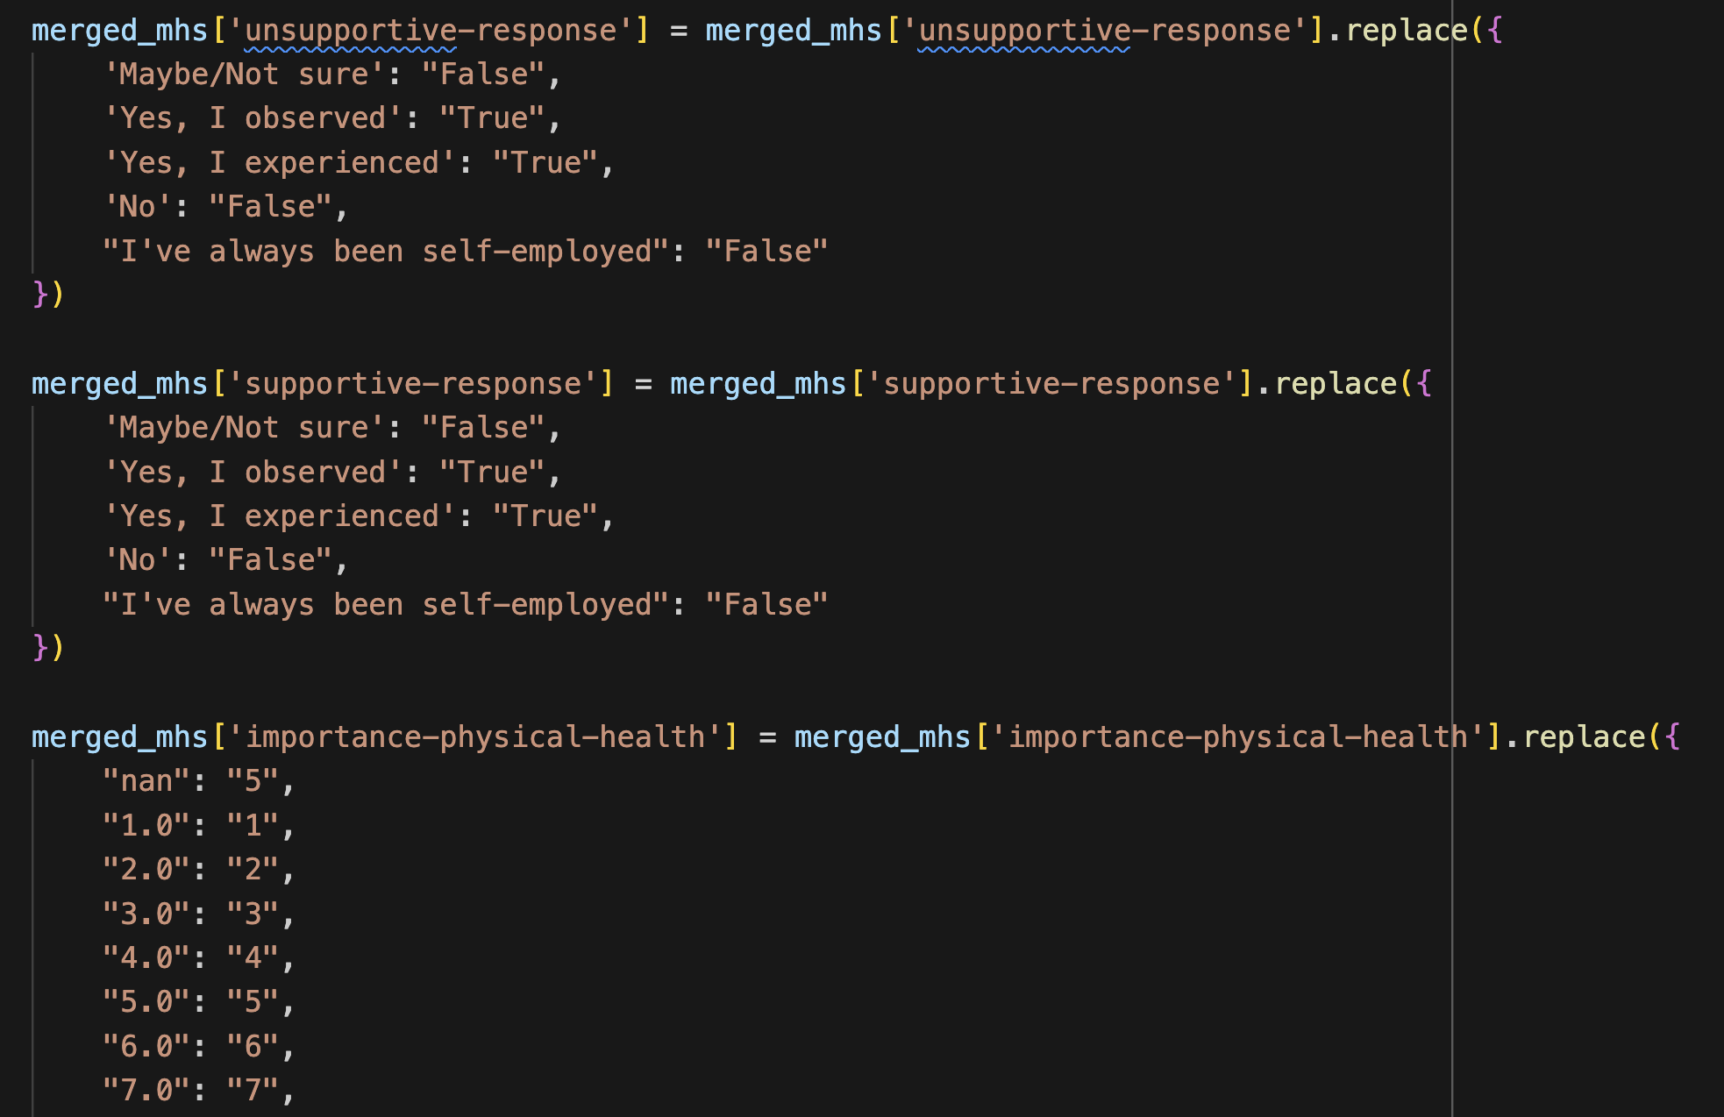
Made the values consistent on 125 cols

Slide 26
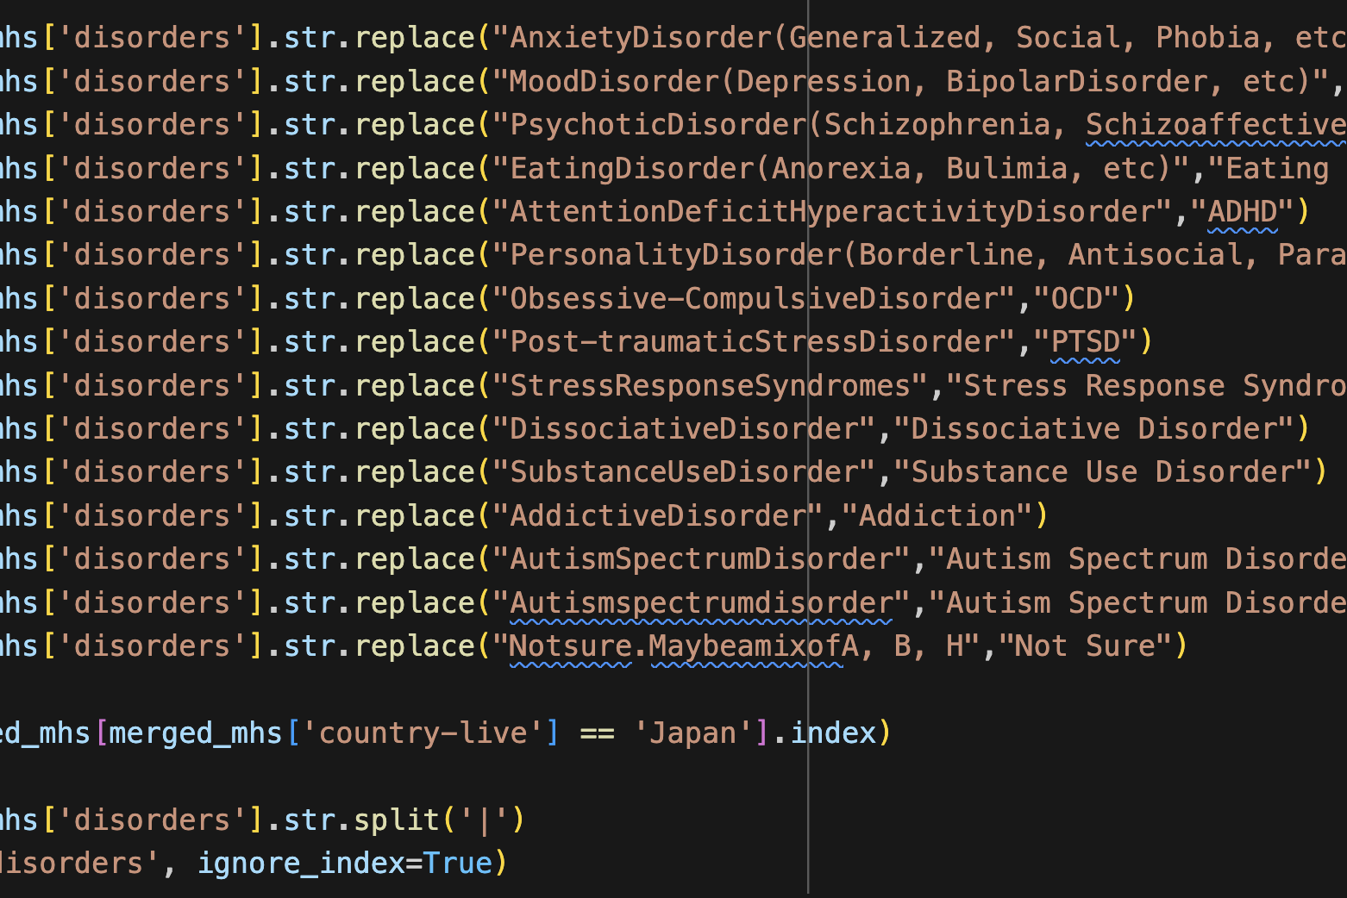
Cleaned the Disorders for consistency and sanity

Slide 27
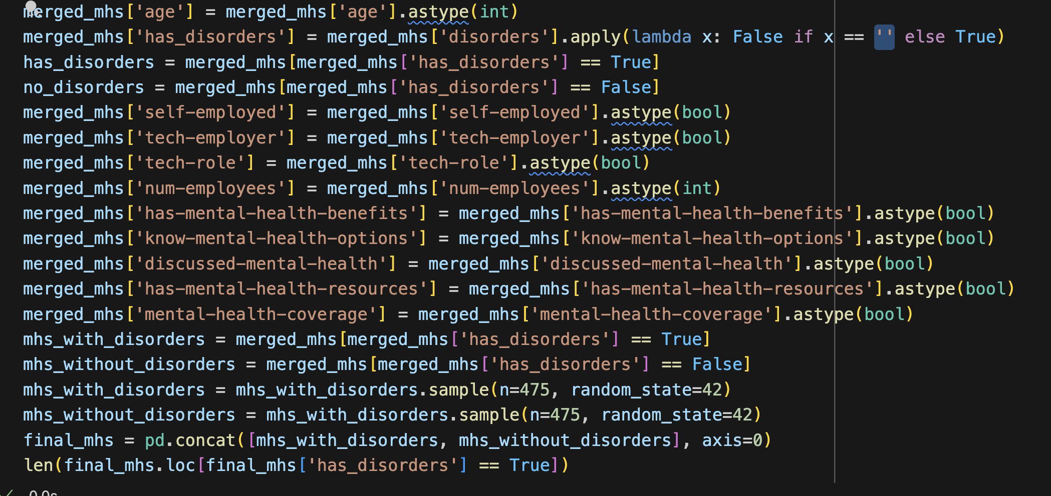
Then fixed some types for fields we needed

Slide 28
Data Thoughts & Recommendations
If you want to write a survey start with an understanding of how you are going to use the data and what is important
Build a general schema that allows that information to be usable and allow for more exploratory analysis
Determine what data points are necessary ASAP so you can elide cleaning non required data.

Slide 29
Mental Health in Tech
Question 1

Slide 30
Do people in Tech Companies or with Tech Roles have more MH issues than their counterparts?

Slide 31
How do we get there?
Clean the data
Prepare 3 visualizations that will provide some insight
Split the data into tech and non tech company
Count entries in each new DF to find out sample size
Sample from both DFs
Merge Sampled DFs back together
Run visualization
Pray to Hanuman

Slide 32
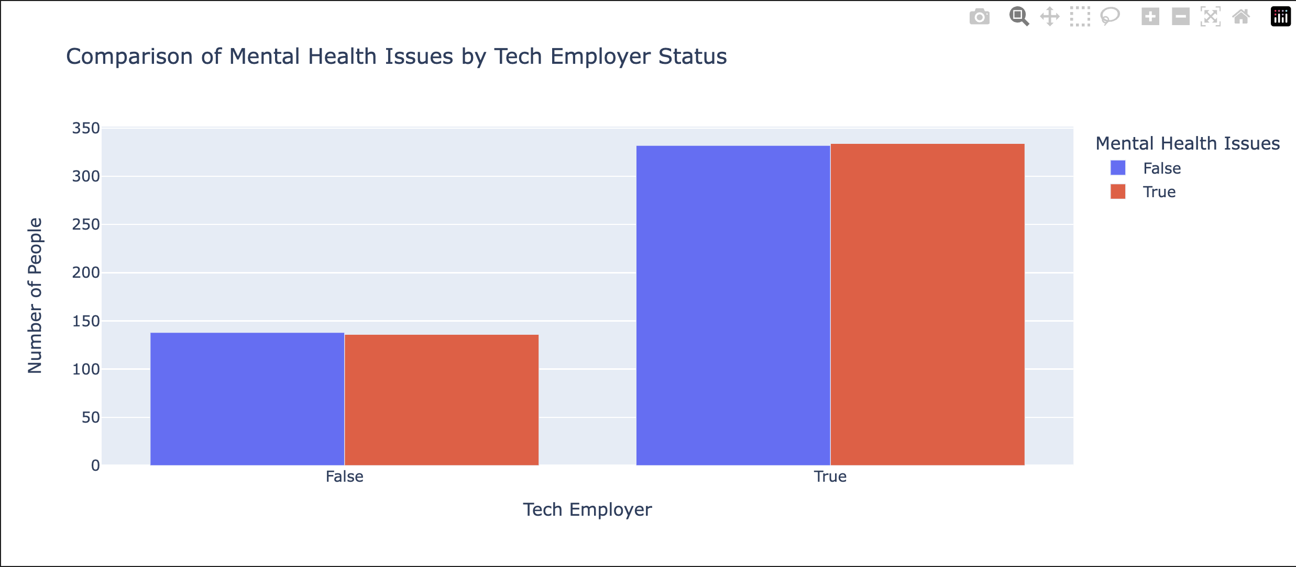
There seems to be very little correlation between MH Issues between Tech vs Non Tech Companies

Slide 33
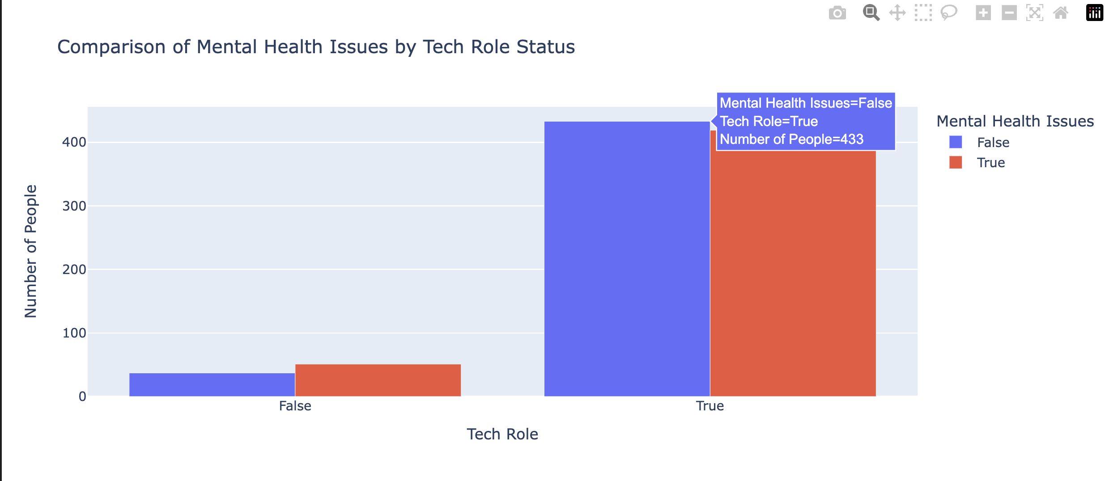
There seems to be very little correlation between MH Issues between Tech vs Non Tech Roles

Slide 34
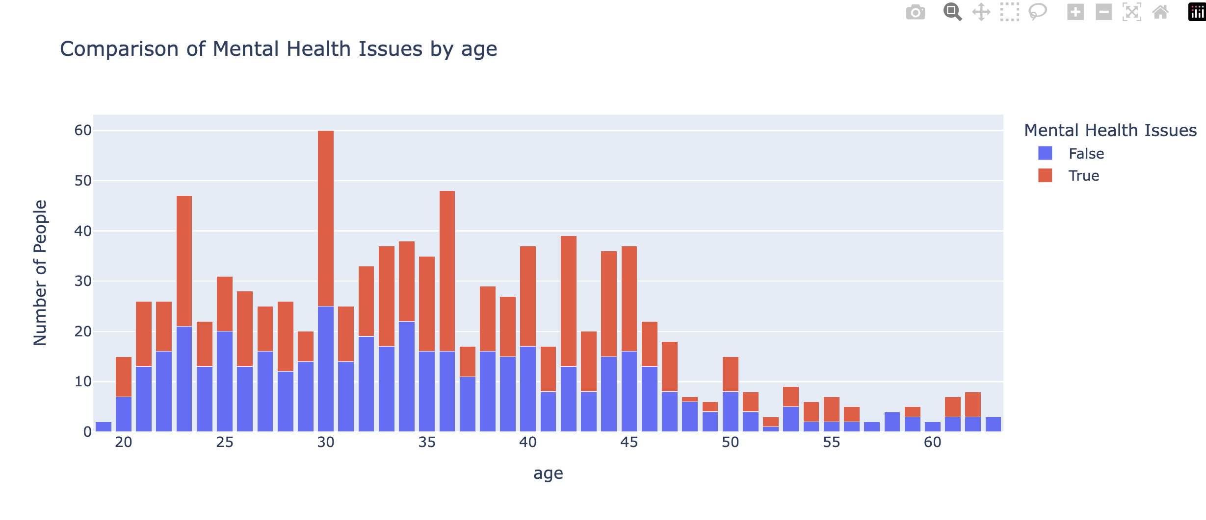
Age does have some correlation to MH issues occurring although perhaps age ranges would be more illustrative.

Slide 35
Analysis & Conclusions
There doesn’t seem to be any correlation between Tech and MH Issues
Is this because of sample size?
Is this because of the burdensome way the survey was structured?
Is Age a factor? Perhaps or it is more about the stress associated with career progression.

Slide 36
Mental Health in Tech
Question 2

Slide 37
Do people in Companies with Wellness Programs have more MH issues then their counterparts?

Slide 38
How do we get there?
Clean the data
Prepare 2 visualizations that will provide some insight
Split data into wellness and non wellness companies
Count entries in each new DF to find out sample size
Sample from both DFs
Merge Sampled DFs back together
Run visualization
Consider our life choices

Slide 39
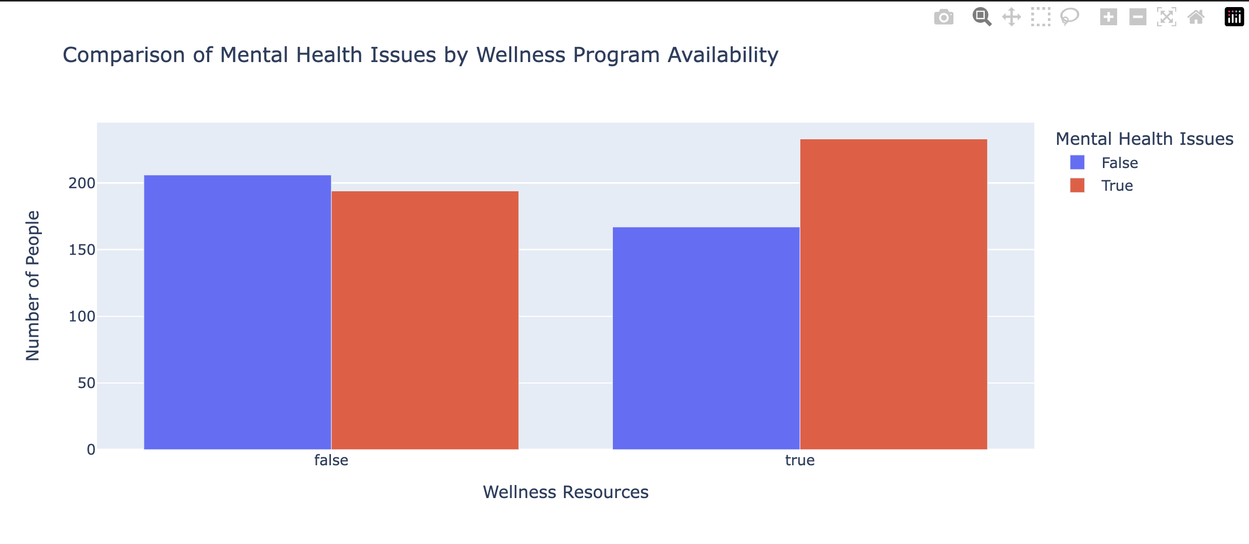

Slide 40
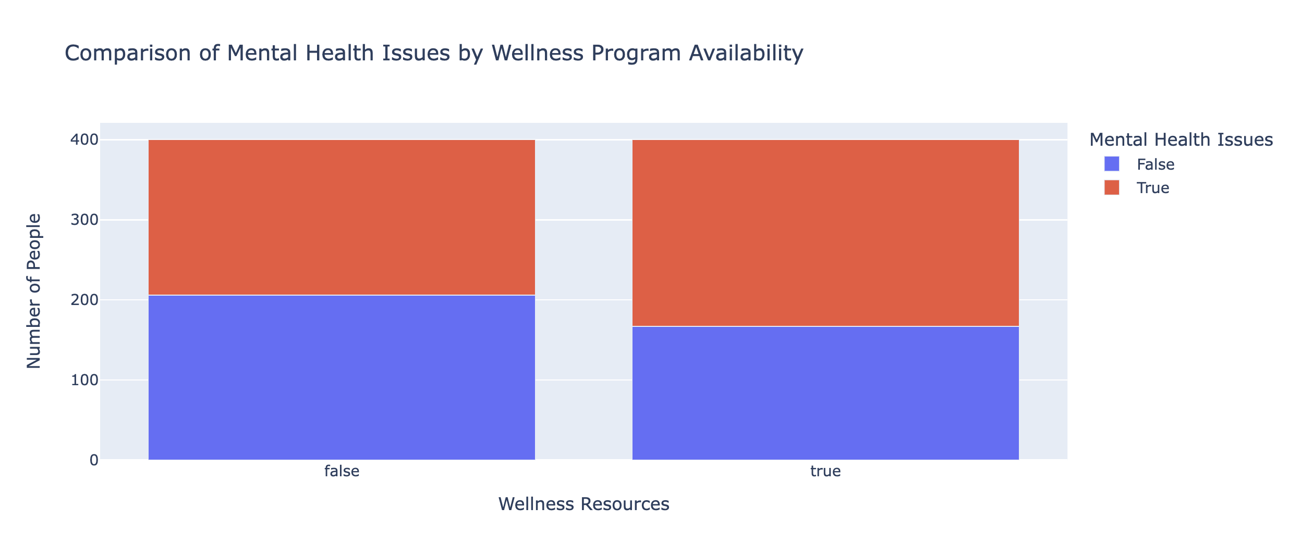

Slide 41
Analysis & Conclusions
There does seem to be any correlation between Wellness Programs and MH Issues
Is this because of wellness programs that more people are less reluctant to admit it?
Is this because of wellness programs that more people seek help?
I

Slide 42
Mental Health in Tech
Question 3

Slide 43
Do USA Tech Employees have more MH issues than International Tech Employees?

Slide 44
How do we get there?
Clean the data
Prepare ~2 visualizations that will provide some insight
Split the data into USA and International locations
Count entries in each new DF to find out sample size
Sample from both DFs
Merge Sampled DFs back together
Run visualization
Weep

Slide 45
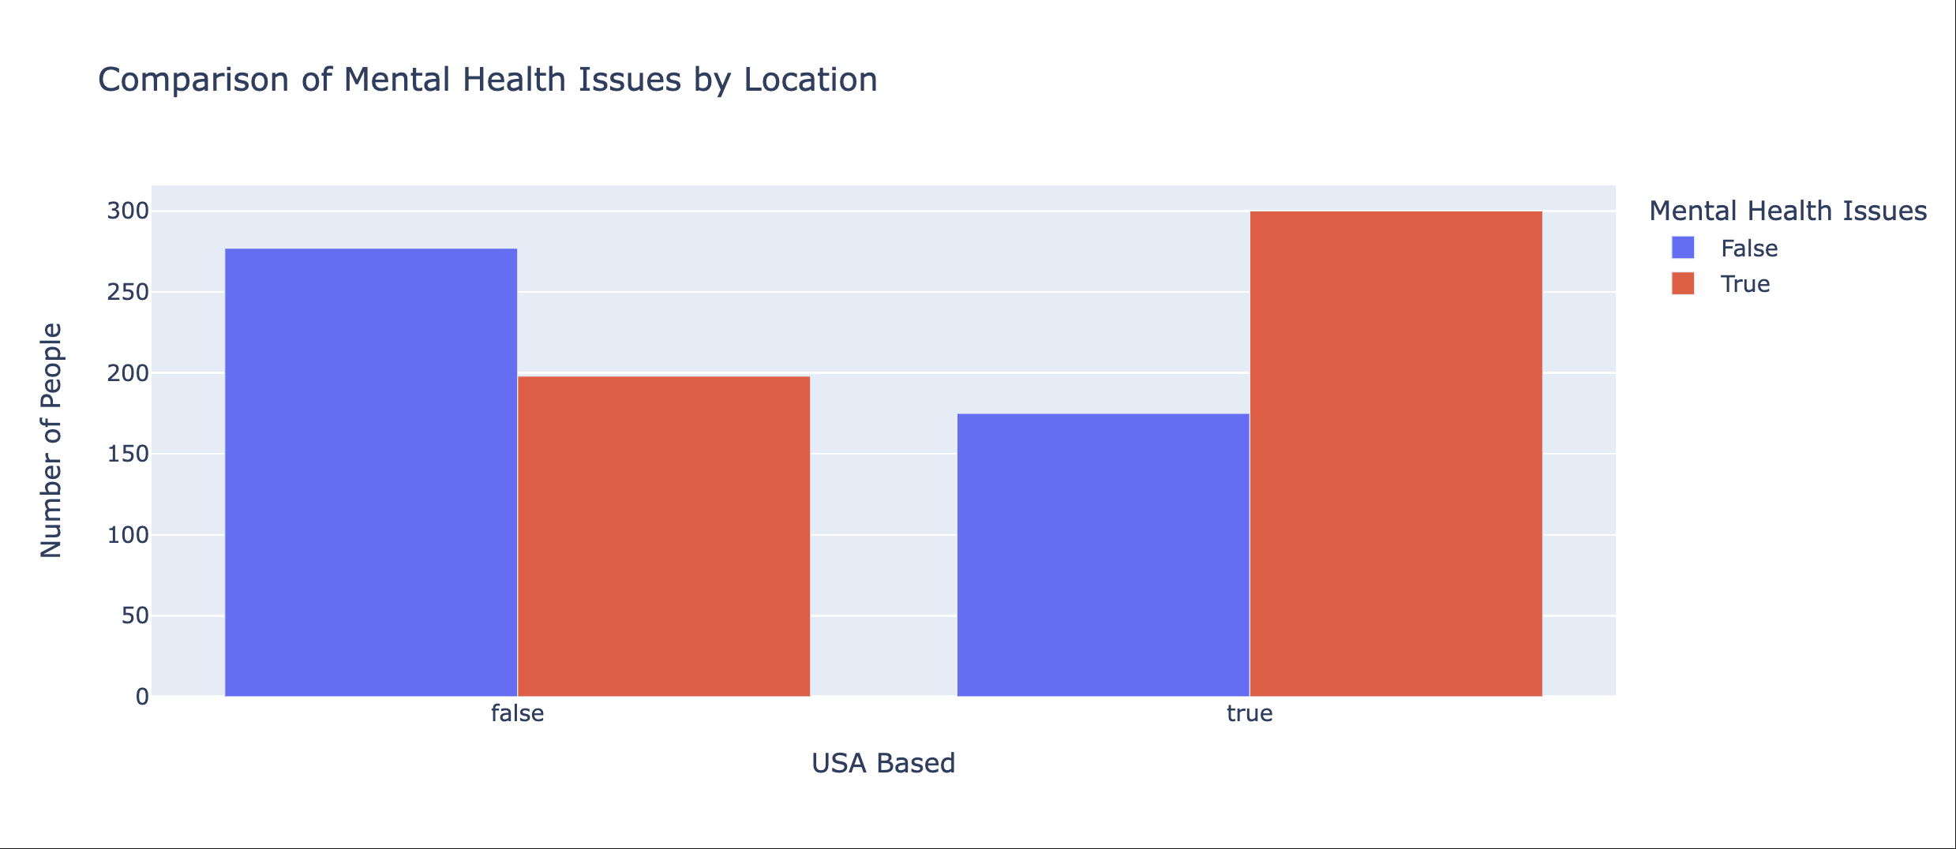

Slide 46
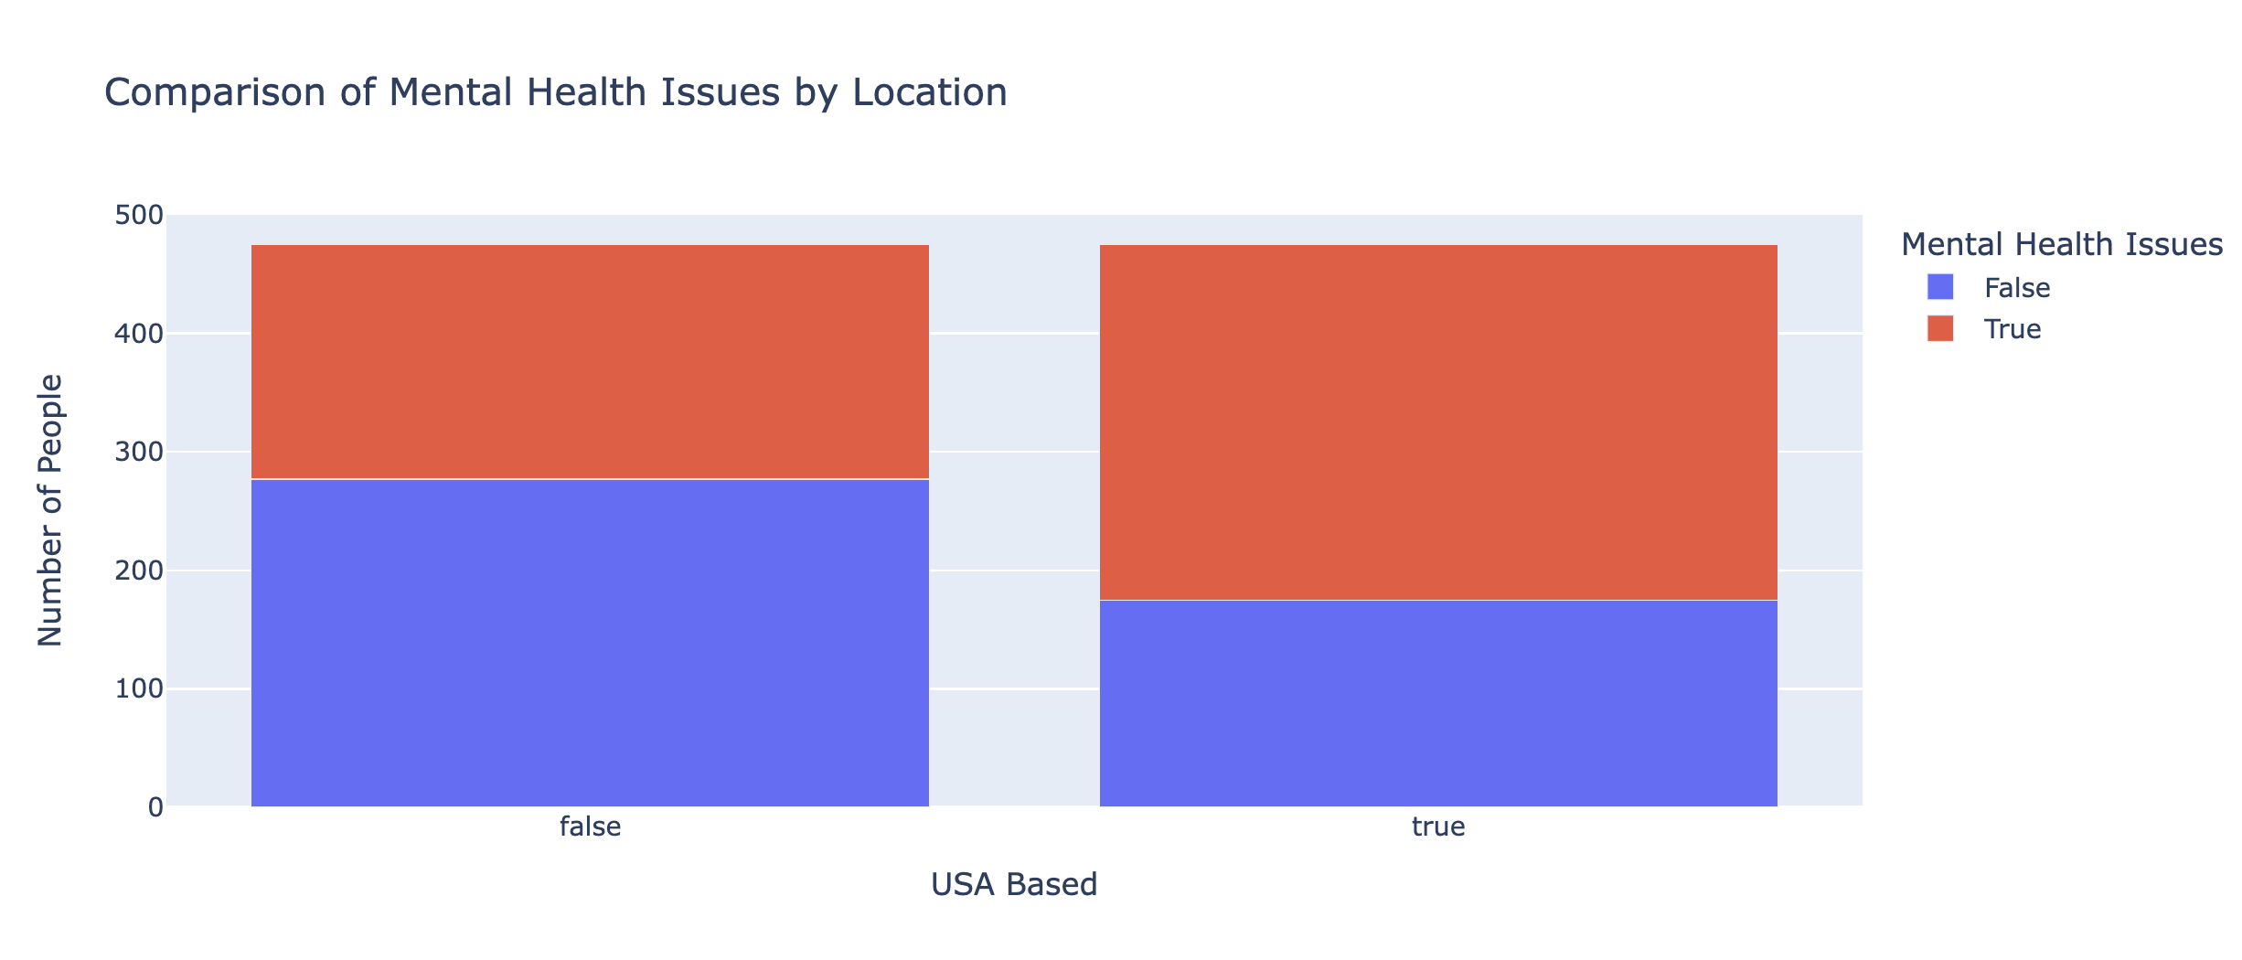

Slide 47
Analysis & Conclusions
The USA has more tech Mental Health issues
Is this because of overall work culture?
Is this because of wellness programs that are built into national health systems
Is it because there is less of a culture of coming forward with MH issues

Slide 48

Not Enough Data

Slide 49
Overall Conclusions
Although I am sure some people could try and use this data to make more correlations, we simply didn’t think many of the ones we could have attempted would have been defendable
Data as a Time Series not reliable enough to use a Prophet Model and attempt a projection
Yes they are mostly bar charts… Mea culpa
Lies, Damn Lies and Statistics and Star Trek does have something to say about it…

Slide 50
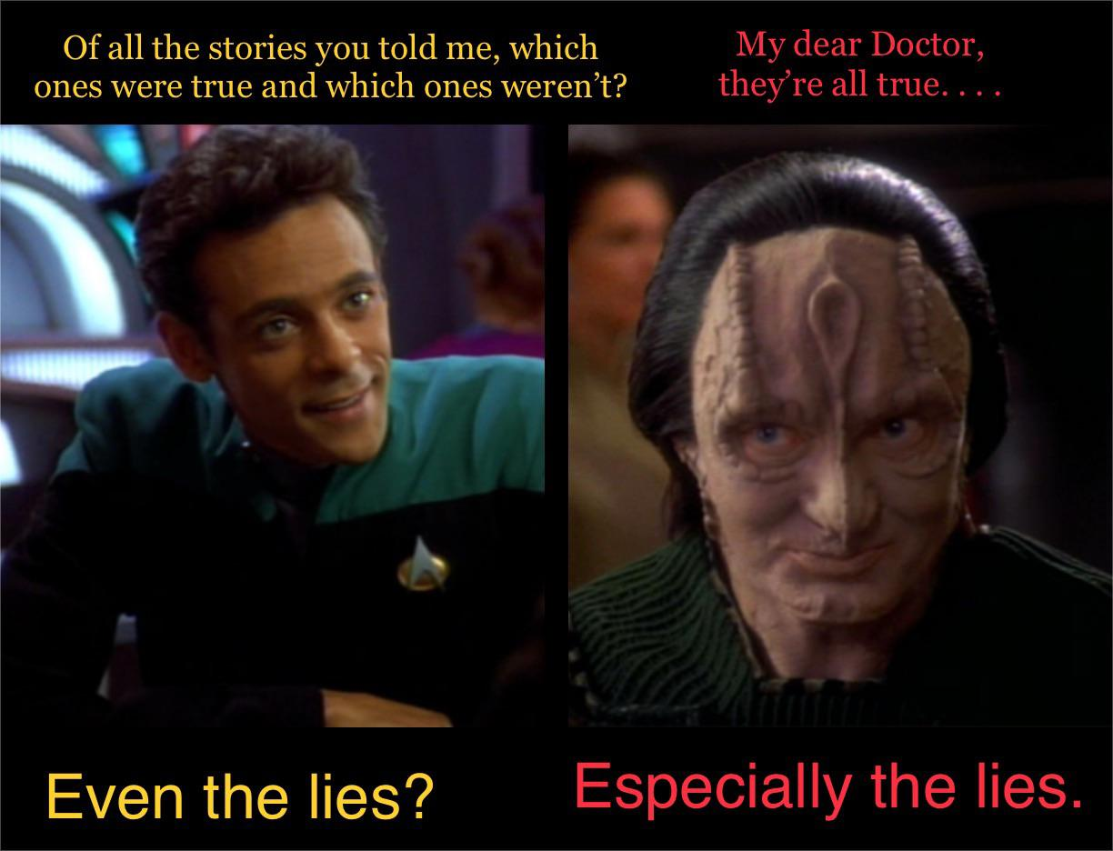

Slide 51
Real ones know DS9 is better than TNG

Slide 52


Slide 53
Thank you for coming to my Ted Talk

Slide 54

Dhruba, Ravi and Brendan

